Slide 1
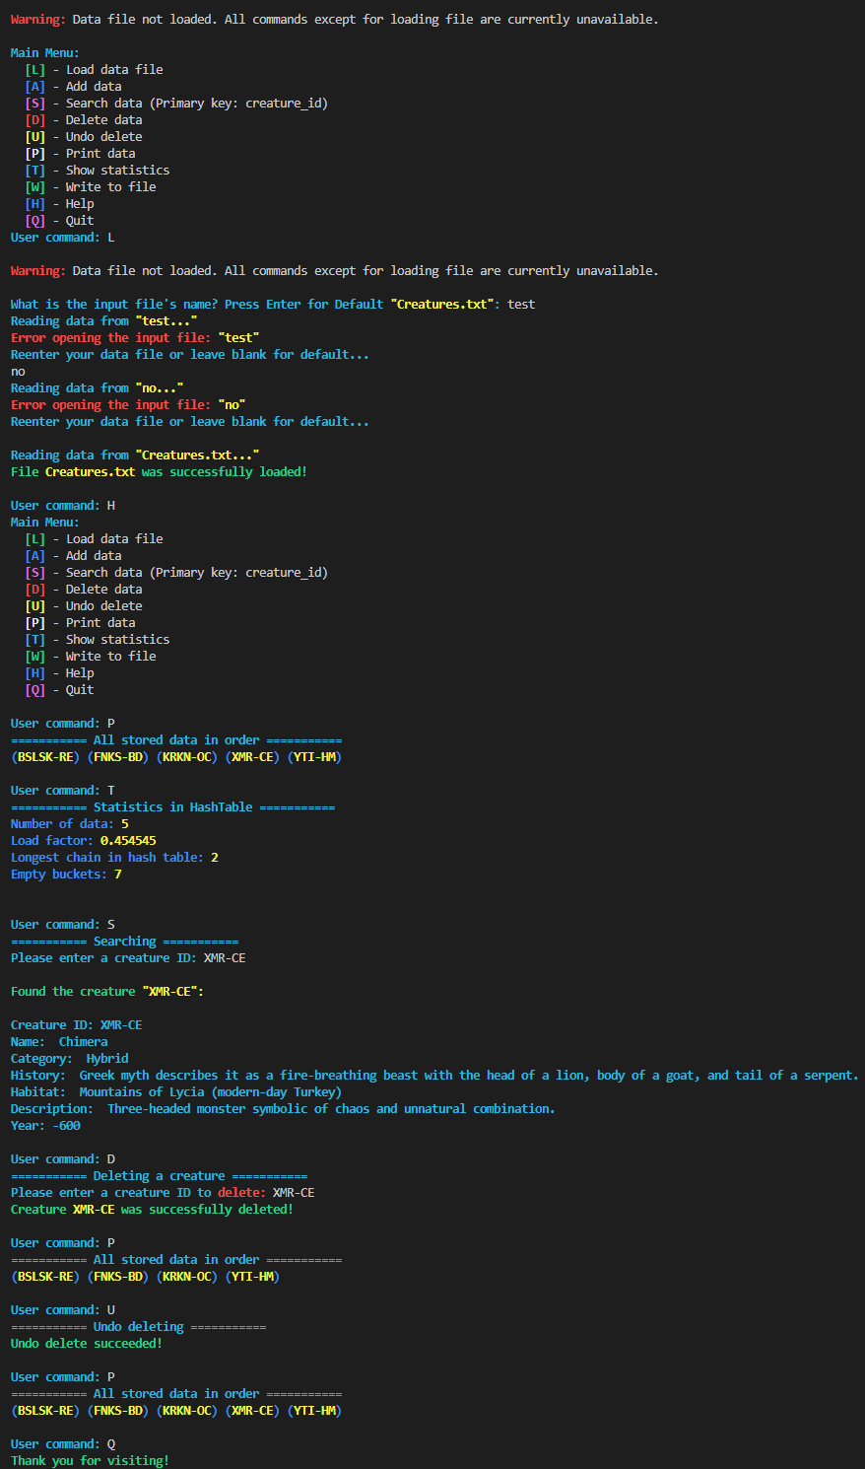
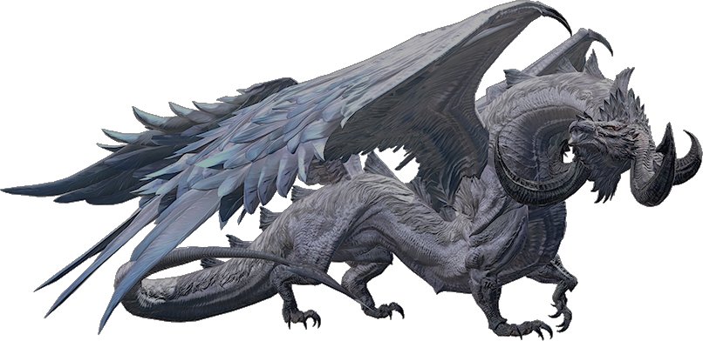
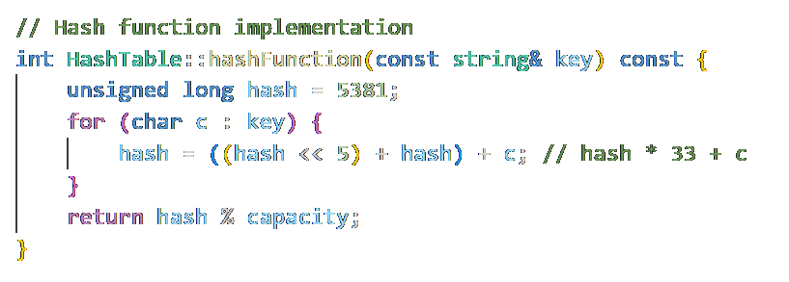
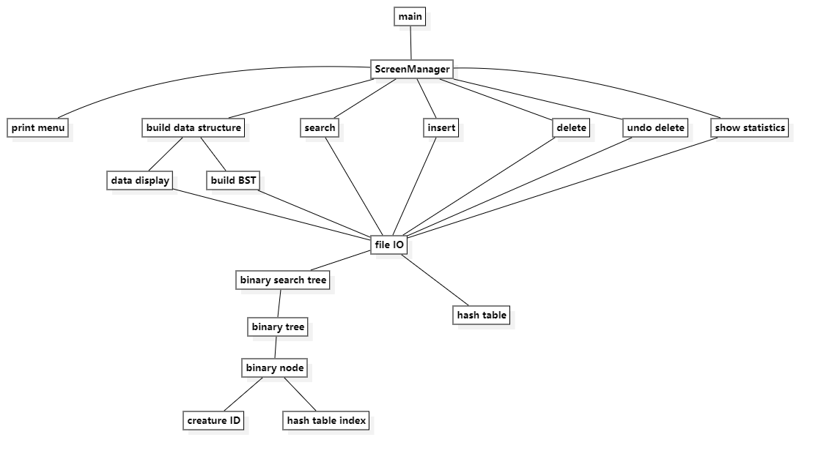
Mythical Creature Catalog
Application Data: Creature
Creature ID (String) – Primary Key, abbreviated name – abbreviated creature type, e.g. FNKS-BD
Name (String) – Full name of creature
Category (String) – Type of creature, e.g. Bird
History (String) – Famous Legend/Myth
Habitat (String) – where the creature lives
Description (String) – standout characteristics
Relevant Year (Integer) – year of first mention/came to relevancy
Sample Run:
Team #7
Team Members:
Shunyao Jin, Leyan Pan, Zachary Rudin, Ye Zhang
Hash function:
Zachary Rudin (Team Leader)
Coordinated the project: defined milestones, assigned tasks, and maintained the overall schedule
Authored weekly progress reports and designed the project poster
Developed main.cpp, implementing the interactive menu and wiring up all menu-driven features
Led system testing to ensure program stability and correctness
Leyan Pan (Hash Table)
Designed and implemented the hash table module using the classic polynomial rolling hash (djb2)
Optimized performance by using bit-shift operations (<<) instead of multiplication
Handled collisions via chaining; each Creature object is stored (in full) in the hash table
Shunyao Jin (BST & File I/O)
Implemented a binary search tree where each node holds a creature’s key and its index in the hash table
Developed the File I/O component to read from and write to the data file, maintaining both the BST and hash table structures
Added automatic rehashing logic in File I/O, ensuring that after a resize the BST node indices remain in sync
Ye Zhang (ScreenManager)
Built ScreenManager.h, which drives all user interactions and menu features
Acts as the bridge between the user interface and the underlying database, formatting and displaying query results and prompts
Structure Chart

Slide 2
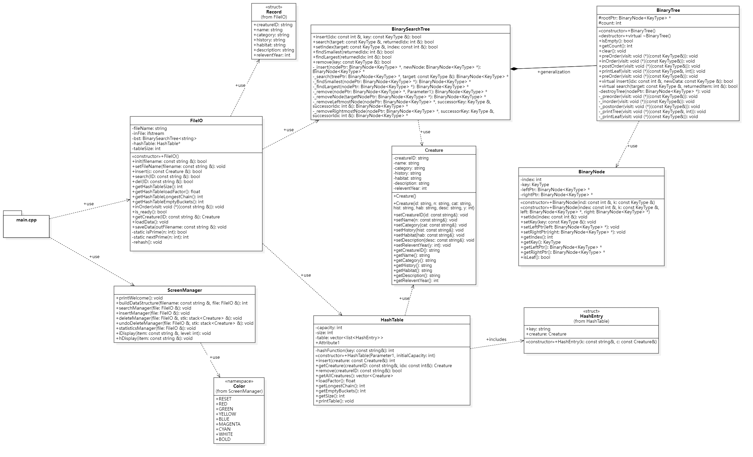
UML diagram

Slide 3
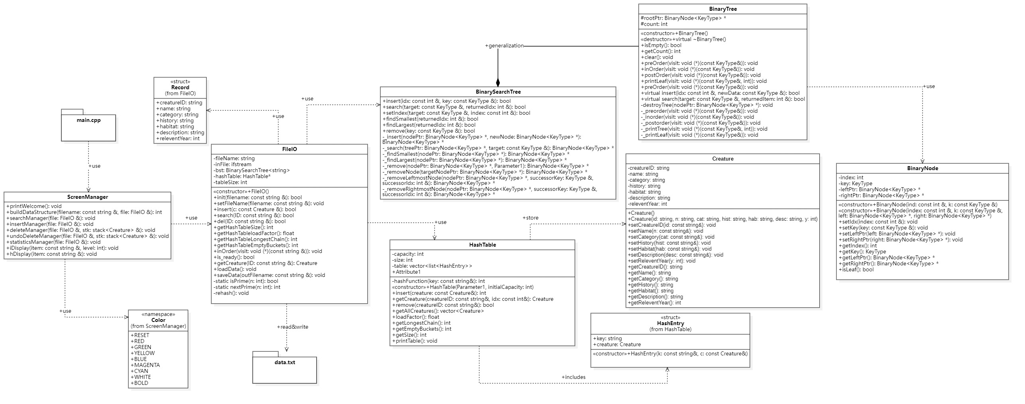
UML diagram

